Slide 1
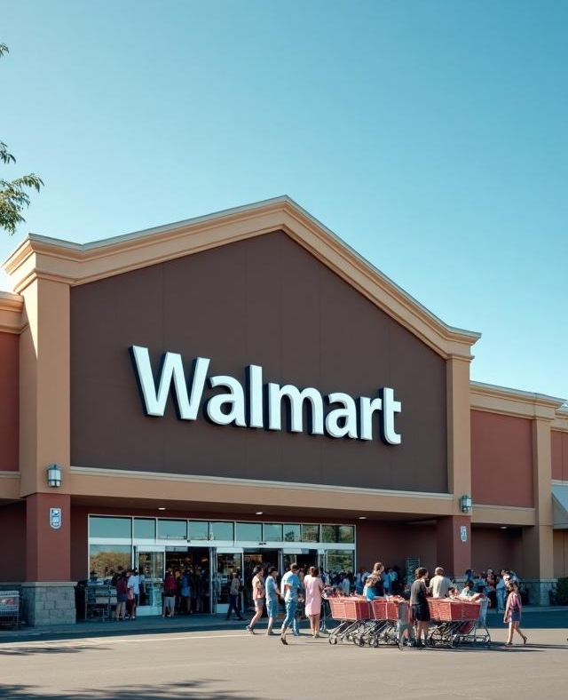
Walmart Sales Analysis
Jenna Doe
Using Python and SQL
By: Tushar
Tech Stack: Python | SQL | Kaggle API

Slide 2
Introduction
In this project, we explore real-world sales data from Walmart, sourced from Kaggle. The aim is to dive into the company's transactional data to uncover useful patterns and trends.
Using Python, the data was cleaned and prepared, and then analyzed through SQL to answer key business questions—like which payment methods are most popular, which branches perform the best, and how customer behavior changes over time. The insights from this analysis can help Walmart make smarter decisions around marketing, operations, and sales strategies.

Slide 3
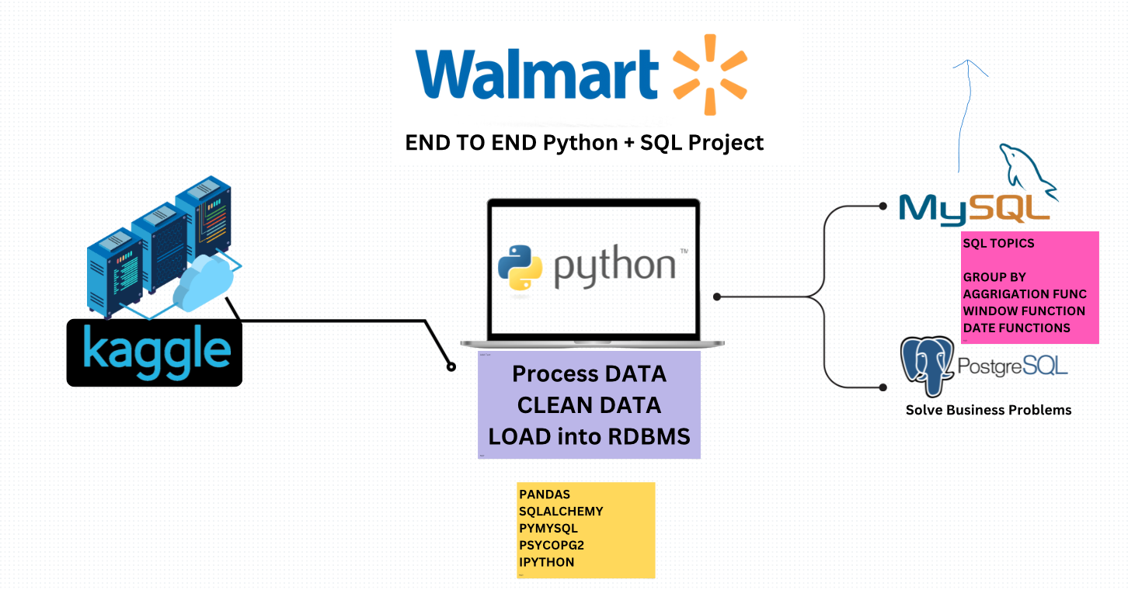
FLow

Slide 4
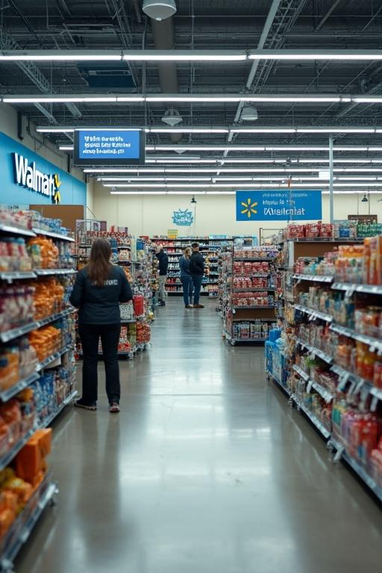
Problem Statment
Walmart is one of the biggest retail stores with many branches and thousands of daily transactions. But with so much data coming in every day, it can be hard to make sense of it all. The sales data is often messy or incomplete, which makes it difficult to directly use for business decisions.
In this project, we aim to clean up and organize Walmart’s sales data using Python, then dig into the details with SQL queries. We want to understand things like which payment methods customers prefer, how different branches are performing, and what products are bringing in the most money. We also look at when the store is busiest so Walmart can better plan their operations.
By uncovering these insights, Walmart can make smarter decisions about marketing, inventory, and staffing to serve customers better and boost sales

Slide 5
Tech Stack
Technology | Purpose
Python | Data cleaning and preprocessing (handling missing data, formatting dates, removing duplicates)
Kaggle API | Downloading the Walmart sales dataset easily and efficiently
MySQL (SQL) | Writing queries to analyze data and answer business questions (grouping, ranking, filtering)

Slide 6

Data source
Dataset: Walmart Sales Dataset
Source: {Walmart Sales Dataset}
Format: .csv
Downloaded using Kaggle API:

Slide 7

Data cleaning
Steps Performed:
Removed Duplicates: Ensured no repeated transactions were present.
Handled Missing Values: Checked for null values and handled them appropriately.
Converted Date Columns: Transformed the date column from string to datetime format using pd.to_datetime().
Extracted Time Features: Created new columns like Year, Month, and Weekday for time-based analysis.
Cleaned Numeric Columns: Ensured numeric fields like quantity, total, unit_price, and rating were in proper formats.
Standardized Column Names (if needed): Renamed columns for consistency and readability.

Slide 8
SQL Business Problem Solving
1)Business problem-Count total transactions
Summary insights-1000+ transactions
2) Business problem-Count by payment method
Summary insights-Credit most used
3)Business problem-Branch count
Summary insights-3 unique branches
4)Business problem-Min quantity sold
Summary Insights-1 item
5)Business problem-Quantity sold by payment
Summary Insights-E-wallet has high volume

Slide 9
SQL Business Problem Solving
6)Business problem-Highest-rated category
Summary Insights-Electronics in Branch A
7)Business problem-Busiest day
Summary Insights-Sunday
8)Business problem-Profit by category
Summary Insights-Food and beverages most profitable
9)Business problem-Revenue drop from 2022 to 2023
Summary Insights-Branch B saw 22% drop

Slide 10
Conclusions
Through this project, I got a chance to dive into Walmart’s real-world sales data and make sense of the numbers behind their daily operations. Using Python, I cleaned and prepared the data, and with the help of SQL, I explored key questions about customer habits, store performance, and payment trends.
The analysis gave some interesting takeaways—like which branch performs best, what time of day sees the most sales, and which product lines are customer favorites. These kinds of insights can help businesses like Walmart make smarter decisions—whether it's stocking the right products, improving customer experience, or planning offers more effectively.
In the end, this project really showed me how powerful data can be when it’s cleaned, questioned, and understood the right way.

